Slide 1
Compiler
Give an English description of the sets of strings generated by the following regular expressions.
(x|y)*x(x|y)
All strings of x’s and y’s ending with xx or xy.
2. p(p|q)*p
All strings of p’s and q’s starting and ending with p.
3. (x|(yxxx))*
All strings of x’s and y’s where every y is followed by at least 3 x’s.
4. (a | b)* abba (a | b)*
All strings of a’s and b’s which contains the substring abba.

Slide 2
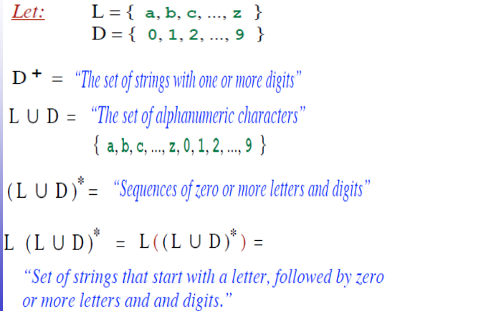
Compiler

